Slide 1
Forecasting the Production of Wheat in Different States of India Using ARIMAX Models
By Subhodip Chakraborty

Slide 2
Forecasting the Production of Wheat in Different States of India Using ARIMAX Models
A presentation by
Subhodip Chakraborty, University of Kalyani
Supervised by
Koulika Paul
Period of Internship: 25th August 2025 – 31st October 2025
Presentation Submitted to: IDEAS – Institute of Data Engineering, Analytics and Science Foundation, ISI Kolkata

Slide 3
OUTLINE
Introduction
Objective
Methodolgy
Results
Conclusions
Future works
References
of the presentation

Slide 4
Introduction

Slide 5
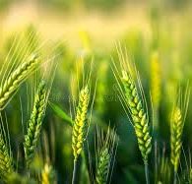
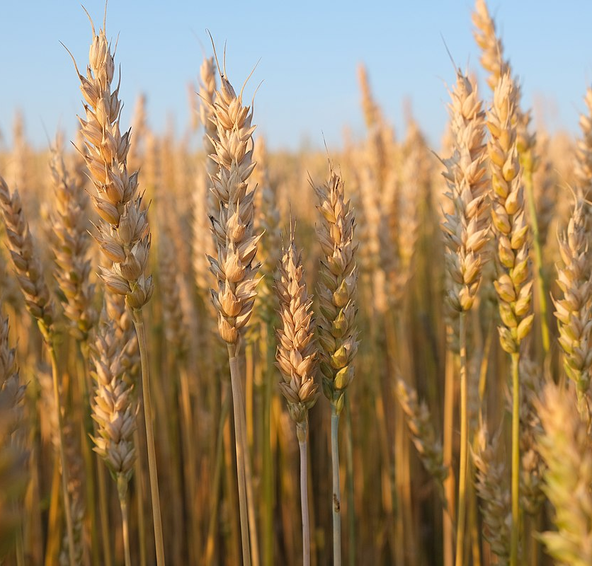
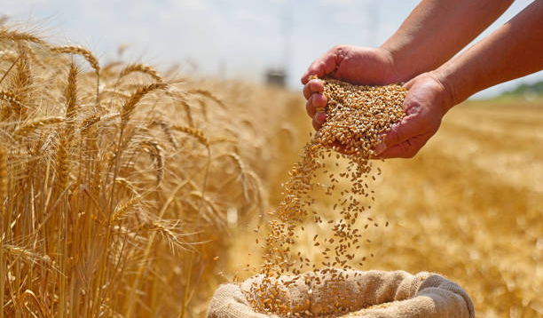
Wheat Production in India
India is the 2nd largest producer of Wheat (Triticum Spp.) in the world.
After Rice, Wheat is the second most produced staple food crop of India.
A large section of population of India relies primarily on Wheat.
For millions of people, especially in northern and central India, Wheat is the primary source of sustenance

Slide 6
Forecasting
Topics covered in Internship
Basic Statistics for data science
Data Visualization
Introduction to GitHub and Cloud computing
Streamlit-1 (Widget handling)
Streamlit-2 (Database Integration)
Machine learning 1 (regression)
Machine learning 2 (classification)
LLM fundamentals
Communication Skills
Forecasting is a process of using a time series model to predict future values with the help of historical, time-ordered data.
Using knowledge of the topics learnt in our Autmn internship at IDEAS, along with various statistical concepts, we have attempted to forecast yield of Wheat for the years 2023 -2025 in 14 different states of India applying ARIMAX model.
With exogenous variables such as temperature of states, amount of rainfall, amount of water available etc, using the data on these variables during 2000 – 2022.

Slide 7
Objective

Slide 8
Objective of the project
The objective behind this work is to forecast production of wheat in the presence of various exogeneous variables such as the temperature of the state (both maximum and minimum), the amount of rainfall in the state, full reservoir level (FRL), Live capacity of the FRL, observed water level and the amount of water available for the year 2023-2025 in 14 Indian states applying ARIMAX model.

Slide 9
Methodology

Slide 10
Data Preparation
Our dataset includes the daily yield of wheat during 2000 - 2022, for various states of India viz. Andhra Pradesh (AP), Chhattisgarh, Gujarat, Jharkhand, Karnataka, Madhya Pradesh (MP), Maharashtra, Odisha, Rajasthan, Tamil Nadu (TN), Telangana, Uttarakhand, Uttar Pradesh (UP) and West Bengal (WB).
Apart from the yield of wheat, the temperature of the state (both maximum and minimum), the amount of rainfall in the state, Full Reservoir Level (FRL), Live capacity of the FRL, observed water level and the amount of water available are also recorded for each day.

Slide 11
Data Preparation
The data recorded for the states Odisha and TN are less than the minimum requirement of data for 5 years, so these states are not considered further.
For each state, the daily data of yield are first converted into monthly means, which were subsequently summed across months to obtain a single annual measure.
The values of the exogenous variables are also converted into annual data for each year available during 2000 – 2022.

Slide 12
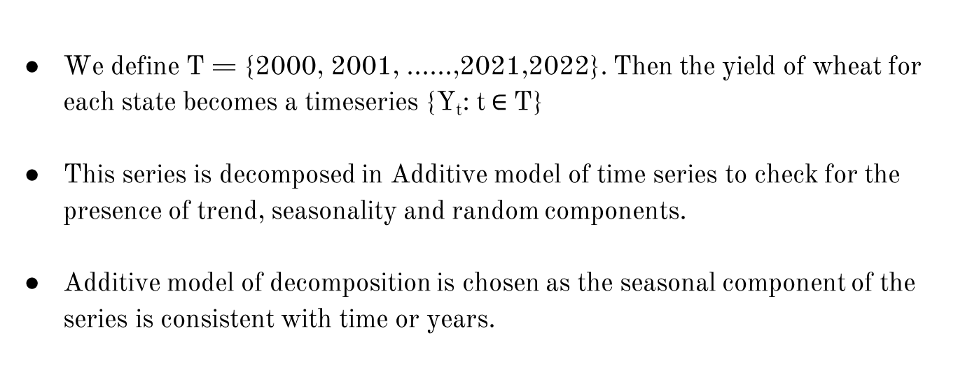
Decomposition of the series
We define T = {2000, 2001, ......,2021,2022}. Then the yield of wheat for each state becomes a timeseries {Y_{t}: t$∈$T}
This series is decomposed in Additive model of time series to check for the presence of trend, seasonality and random components.
Additive model of decomposition is chosen as the seasonal component of the series is consistent with time or years.

Slide 13
Decomposition of the series
The general tendency of the data to increase or decrease over a long period of time is known as Trend.
The rhythmic forces operating in a regular and periodic manner year with period less than a year leads to “Seasonal variations” in a time series data.
Apart from the regular components of a Time series mentioned above, a time series data generally contains fluctuations which are purely random, erratic, unforeseen, and unpredictable. These fluctuations are known as random movements.

Slide 14
Decomposition of the series
Suppose at a year t, the value of a time series is Y_{t}, and that of trend, seasonal variations, cyclical variations and random movements are T_{t}, S_{t}, C_{t} and R_{t} respectively.
Here, a time series is expressed as
Y_{t} = T_{t} + S_{t} + C_{t} + R_{t} (1)
The additive model assumes that all the components of a time series operate independently of each other.

Slide 15
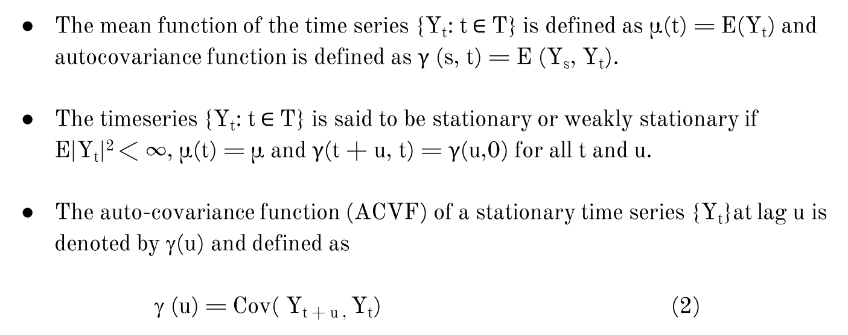
Stationarity of the series
The mean function of the time series {Y_{t}: t$∈$T} is defined as µ(t) = E(Y_{t}) and autocovariance function is defined as γ (s, t) = E (Y_{s}, Y_{t}).
The timeseries {Y_{t}: t$∈$T} is said to be stationary or weakly stationary if E|Y_{t}|² < ∞, µ(t) = µ and γ(t + u, t) = γ(u,0) for all t and u.
The auto-covariance function (ACVF) of a stationary time series {Y_{t}}at lag u is denoted by γ(u) and defined as
γ (u) = Cov( Y_{t + u ,} Y_{t}) (2)

Slide 16
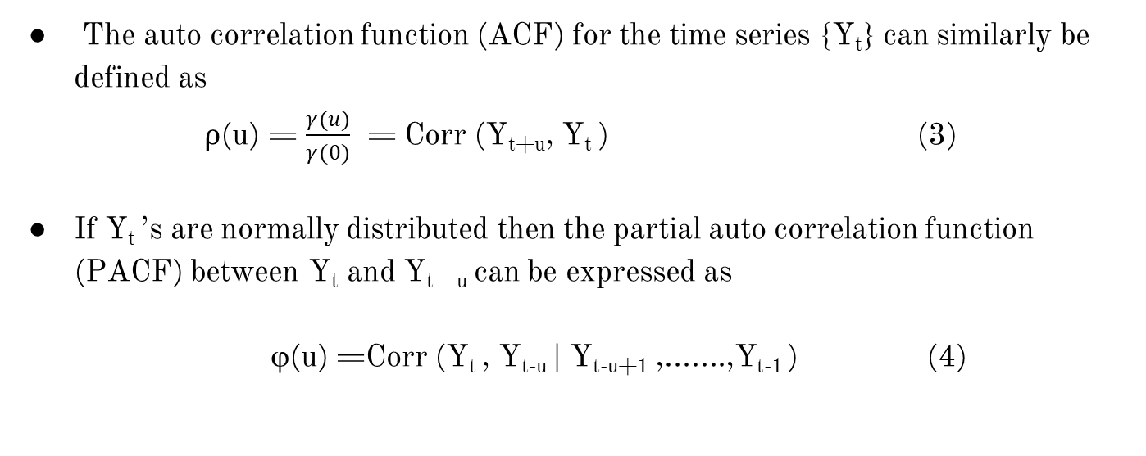
Stationarity of the series : ACF & PACF
The auto correlation function (ACF) for the time series {Y_{t}} can similarly be defined as
ρ(u) = $\frac{γ(u)}{γ(0)}$ = Corr (Y_{t+u}, Y_{t} ) (3)
If Y_{t} ’s are normally distributed then the partial auto correlation function (PACF) between Y_{t} and Y_{t – u} can be expressed as
ϕ(u) =Corr (Y_{t} , Y_{t-u} | Y_{t-u+1} ,.......,Y_{t-1} ) (4)

Slide 17
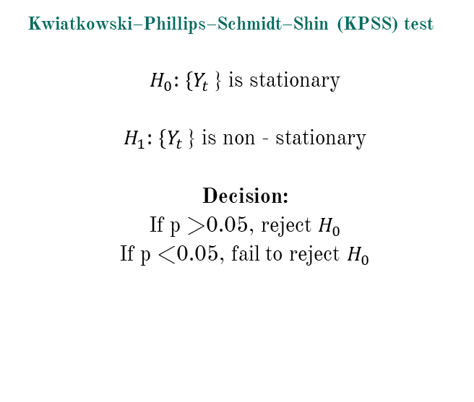
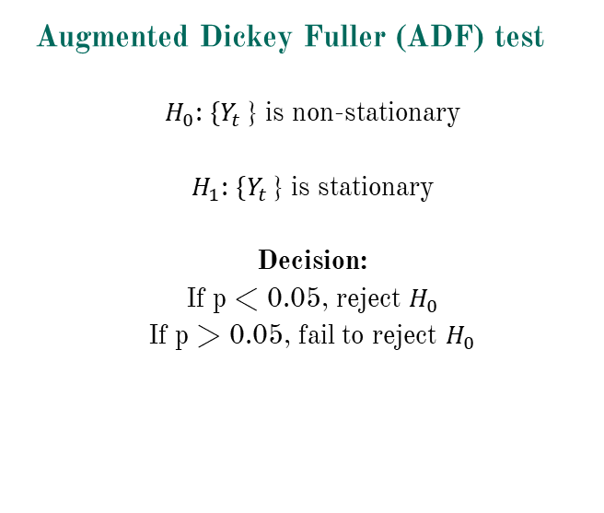
Stationarity of the series : Statistical Tests
Augmented Dickey Fuller (ADF) test
$H_{0}$: $\{Y_{t }$} is non-stationary
$H_{1}$: $\{Y_{t }$} is stationary
Decision:
If p < 0.05, reject $H_{0}$
If p > 0.05, fail to reject $H_{0}$
Kwiatkowski–Phillips–Schmidt–Shin (KPSS) test
$H_{0}$: $\{Y_{t }$} is stationary
$H_{1}$: $\{Y_{t }$} is non - stationary
Decision:
If p >0.05, reject $H_{0}$
If p <0.05, fail to reject $H_{0}$

Slide 18
Stationarity of the series
Furthermore, we also plotted the ACF and PACF values for each state.
If the series is non-stationary, the ACF values decays slowly over lags and PACF values cuts off after very few lags.
For the states having non-stationary data, we had applied differencing to make them stationary.

Slide 19
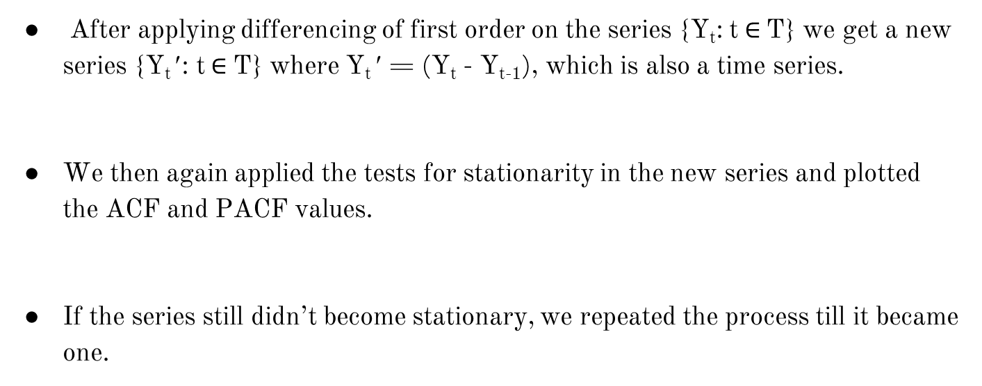
Stationarity of the series : Differencing
After applying differencing of first order on the series {Y_{t}: t$∈$T} we get a new series {Y_{t} ′: t$∈$T} where Y_{t} ′ = (Y_{t} - Y_{t-1}), which is also a time series.
We then again applied the tests for stationarity in the new series and plotted the ACF and PACF values.
If the series still didn’t become stationary, we repeated the process till it became one.

Slide 20
ARIMAX forecasting
The ARIMAX model is an extension of ARIMA (Auto Regressive Integrated Moving Averages) models that incorporates one or more exogenous variables (X) that are thought to have an impact on dependent variables (Y).
Exogeneous variable are the variables that are determined not by the economic model but by external factors.
In our model. The variables viz. maximum temperature of state, minimum temperature of state, amount of rainfall in the state, FRL, live capacity of FRL, observed water level and the amount of water available acted as exogenous variables.

Slide 21
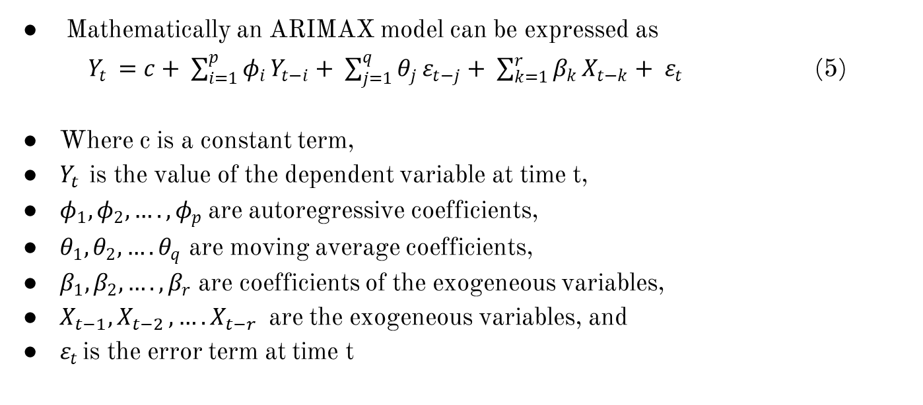
ARIMAX forecasting
Mathematically an ARIMAX model can be expressed as
$Y_{t }=c+ \sum_{i=1}^{p}{φ_{i}}Y_{t−i}+ \sum_{j=1}^{q}{θ_{j}}ε_{t−j}+ \sum_{k=1}^{r}{β_{k}}X_{t−k}+ ε_{t}$ (5)
Where c is a constant term,
$Y_{t }$is the value of the dependent variable at time t,
$φ_{1}, φ_{2},…., φ_{p}$are autoregressive coefficients,
$θ_{1}, θ_{2},…. θ_{q}$ are moving average coefficients,
$β_{1}, β_{2},….,β_{r}$ are coefficients of the exogeneous variables,
$X_{t−1}{,X}_{t−2},….X_{t−r}$are the exogeneous variables, and
$ε_{t }$is the error term at time t

Slide 22
ARIMAX forecasting
If differencing is applied, the model becomes ARIMAX (p,d,q), where d is the order of differencing.
Various ARIMAX models, depending on the values of p, d and q have been fitted for each state.
The model with lowest Akaike information criterion (AIC) value has been chosen as the best model.
The performance of the ARIMAX models for every state is evaluated using error metrics such as Mean Absolute Error (MAE), Mean Squared Error (MSE) and Mean Absolute Percentage Error (MAPE).

Slide 23
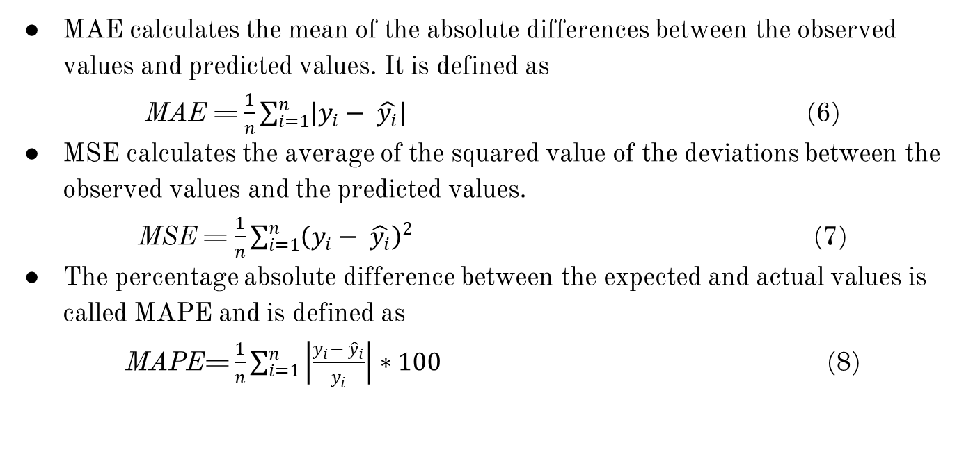
ARIMAX forecasting
MAE calculates the mean of the absolute differences between the observed values and predicted values. It is defined as
MAE = $\frac{1}{n}\sum_{i=1}^{n}{\left|y_{i}− \hat{y_{i}}\right|}$ (6)
MSE calculates the average of the squared value of the deviations between the observed values and the predicted values.
MSE = $\frac{1}{n}\sum_{i=1}^{n}{{\left(y_{i}− \hat{y_{i}}\right)}^{2}}$ (7)
The percentage absolute difference between the expected and actual values is called MAPE and is defined as
MAPE= $\frac{1}{n}\sum_{i=1}^{n}{\left|\frac{y_{i}− {\hat{y}}_{i}}{y_{i}}\right|}∗100$ (8)

Slide 24
Results

Slide 25
Setup
In the experimental setup, Windows 11 was used as the operating system, with a 12th Gen Intel(R) Core(TM) i3-1215U processor (1.20 GHz).
All models were implemented locally in Visual Studio Code using Python 3.12.4 and PyTorch 2.8.0 compiled with CPU.
Training was performed on Windows 11 ( Intel 64-bit processor, Family 6 Model 154 Stepping4).

Slide 26
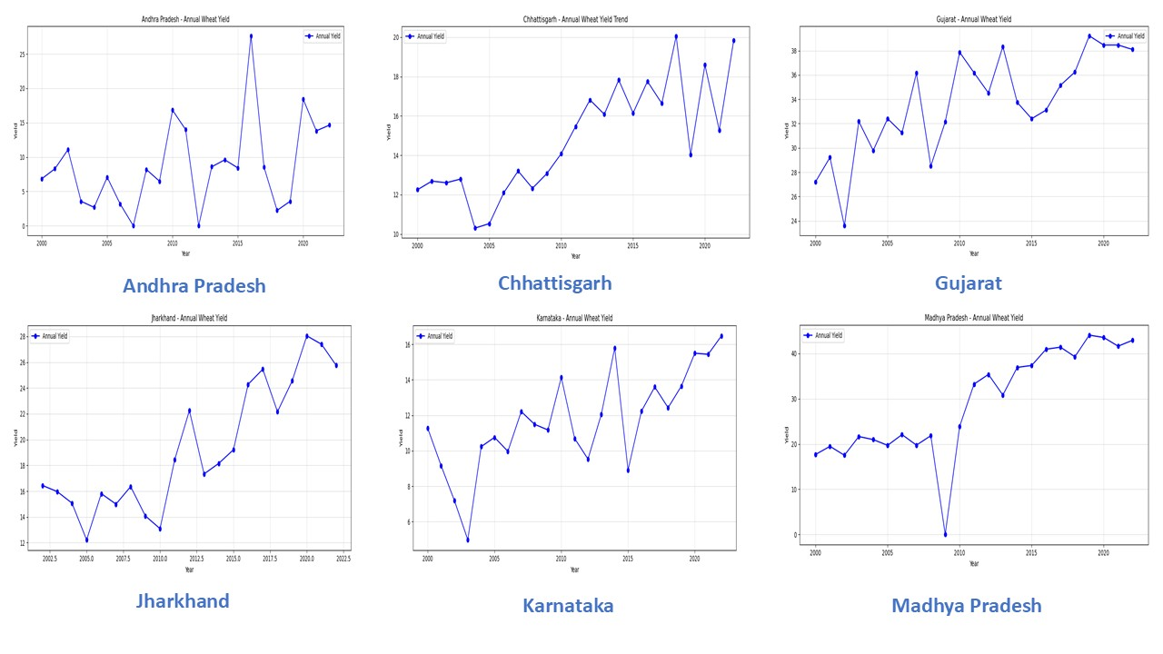
Year - wise plot of yield

Slide 27
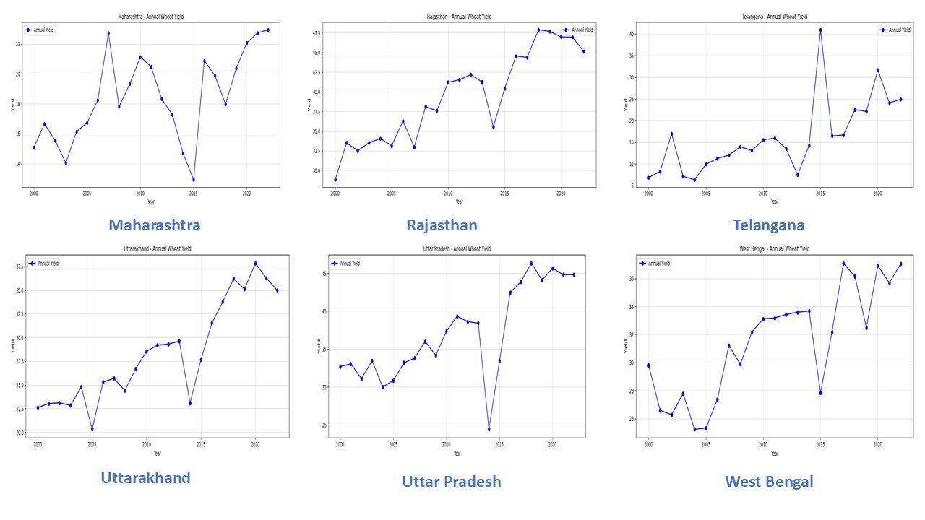
Year - wise plot of yield (Contd.)

Slide 28
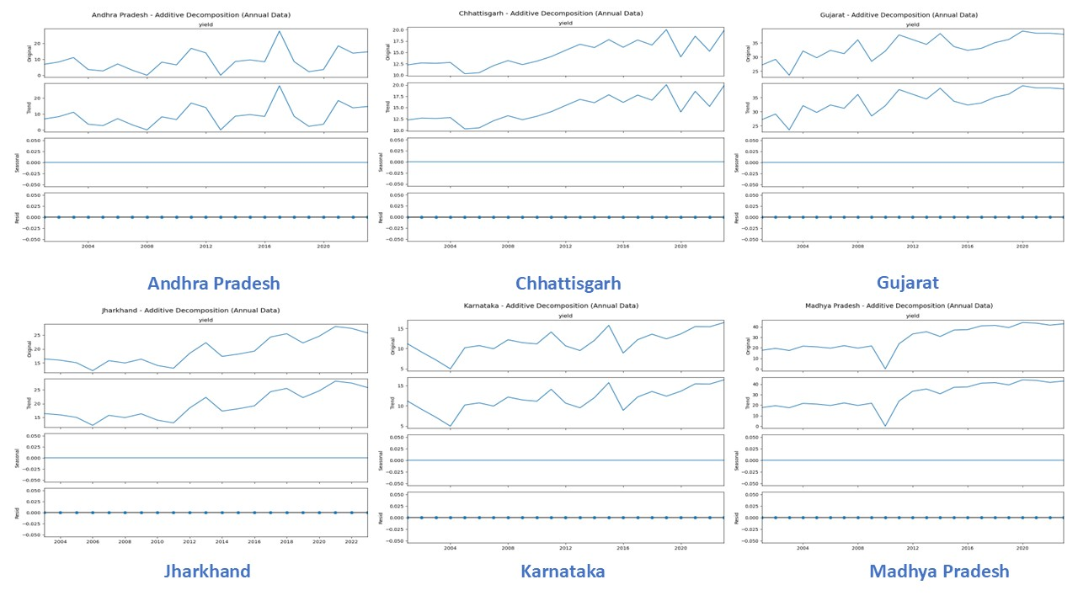
Additive decomposition for yield

Slide 29
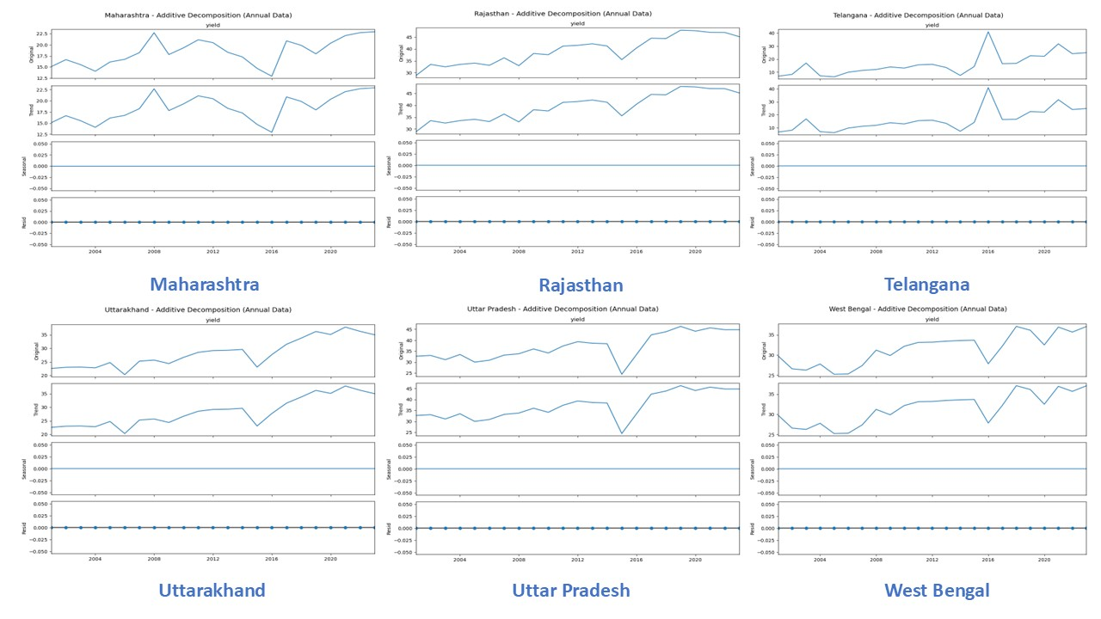
Additive decomposition for yield (Contd.)

Slide 30
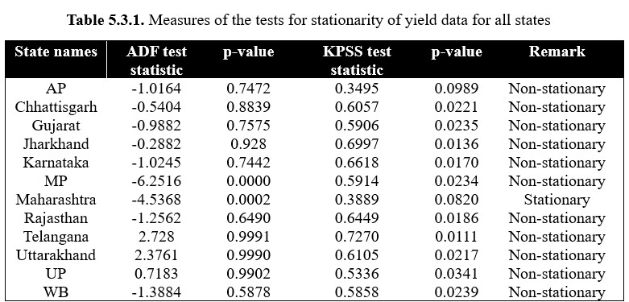
Stationarity: Results of stationarity tests

Slide 31
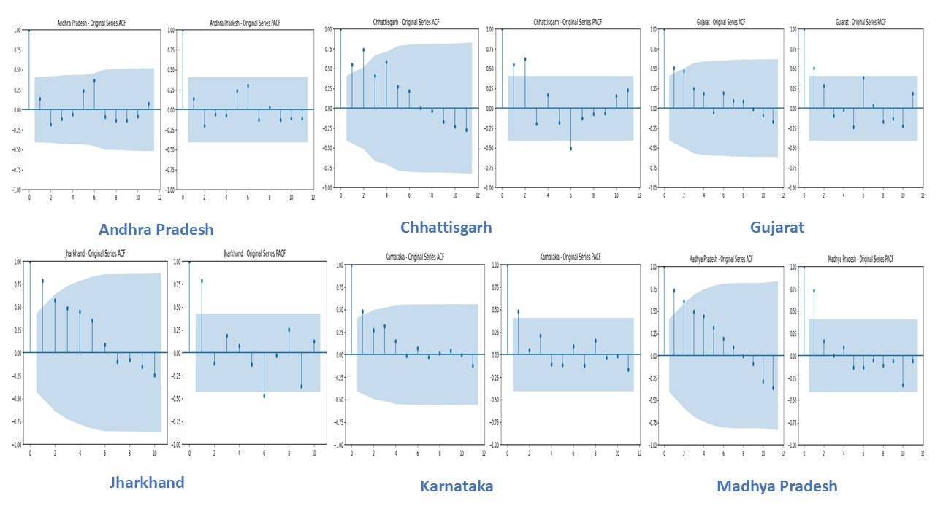
Stationarity: ACF & PACF plots

Slide 32
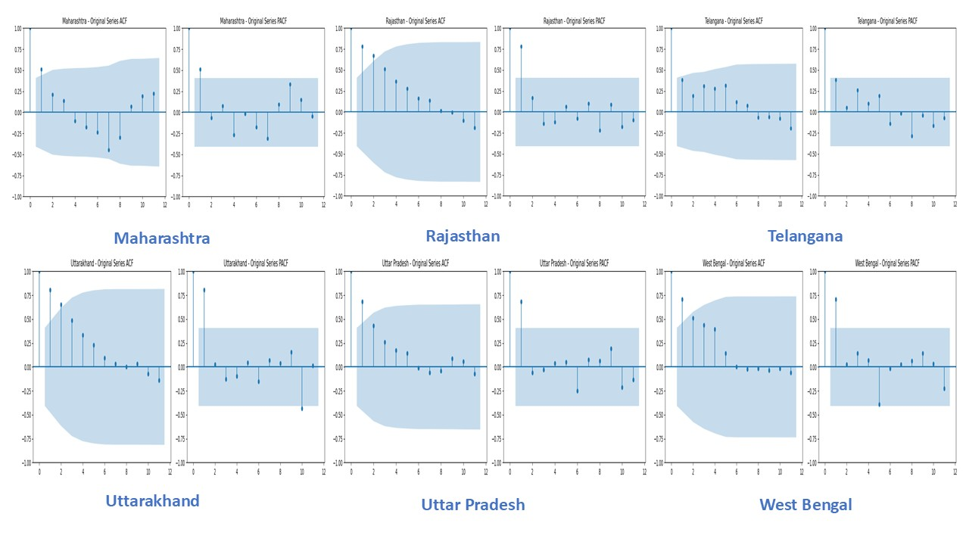
Stationarity: ACF & PACF plots (Contd.)

Slide 33
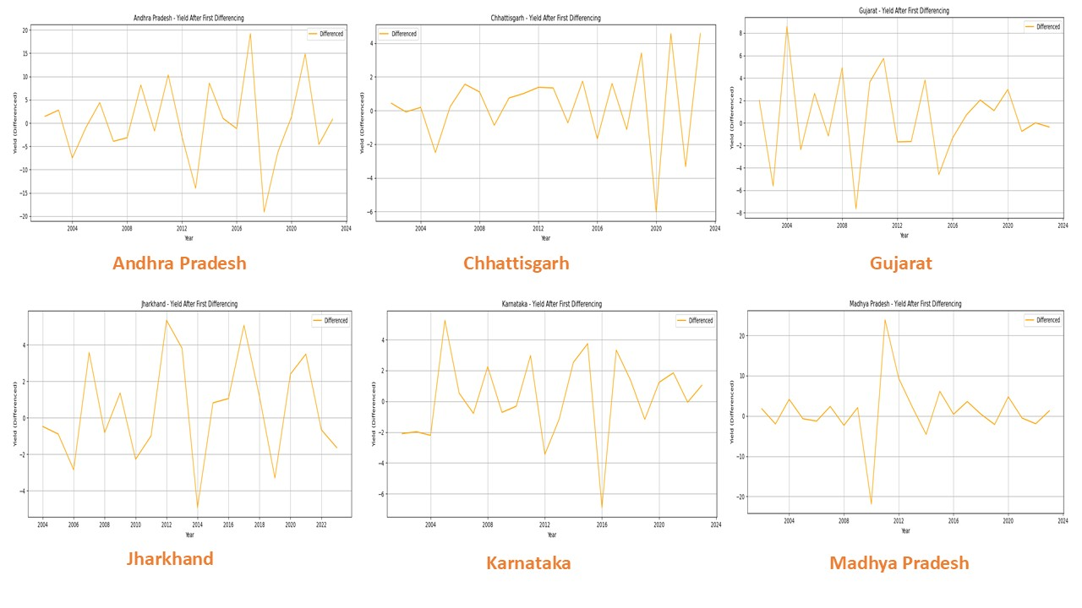
Stationarity: Differencing for non –stationary series

Slide 34
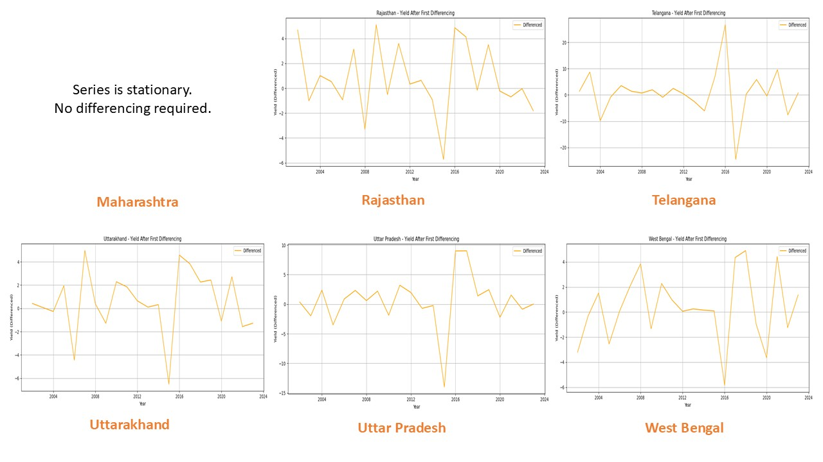
Stationarity: Differencing for non –stationary series (contd.)

Slide 35
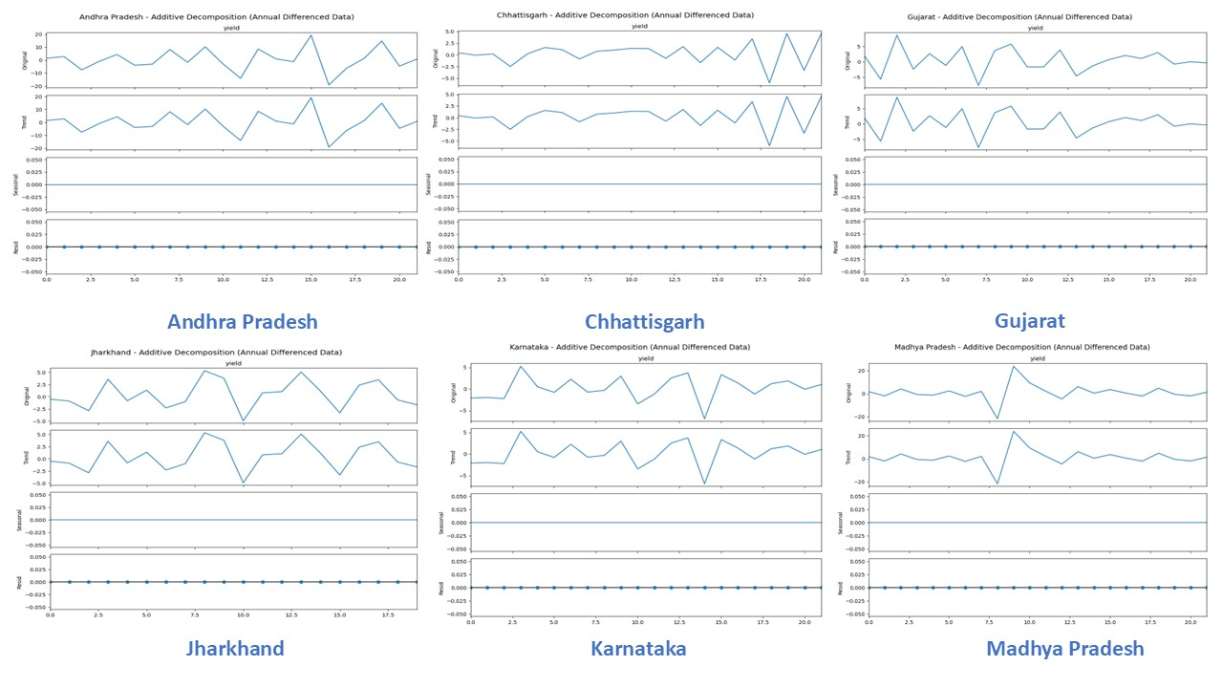
Stationarity: Additive decomposition

Slide 36
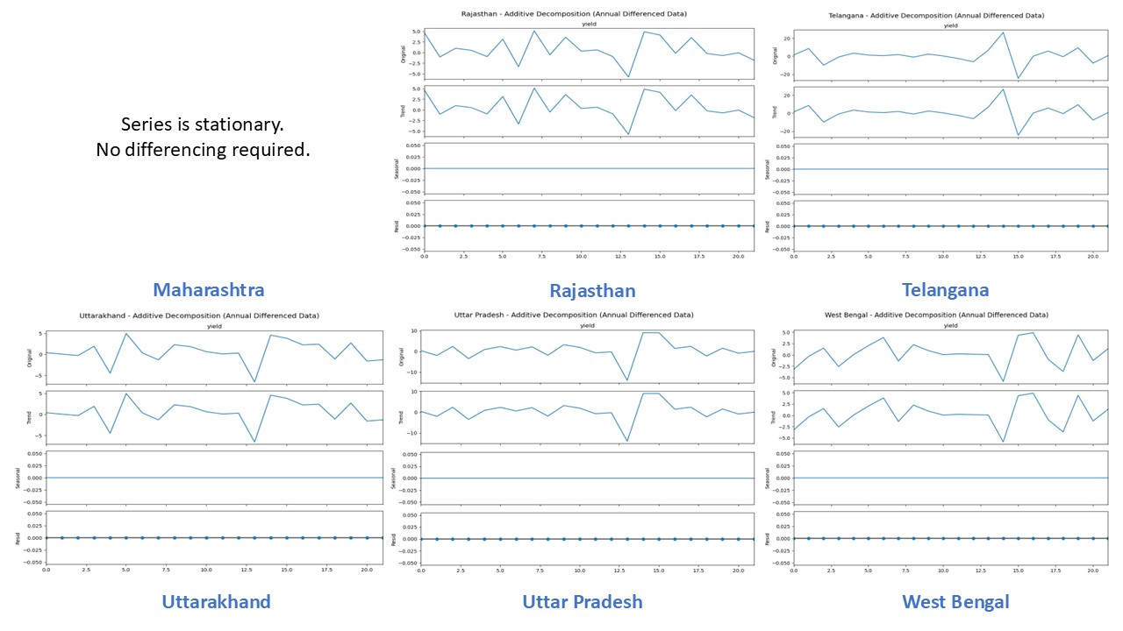
Stationarity: Additive decomposition (Contd.)

Slide 37
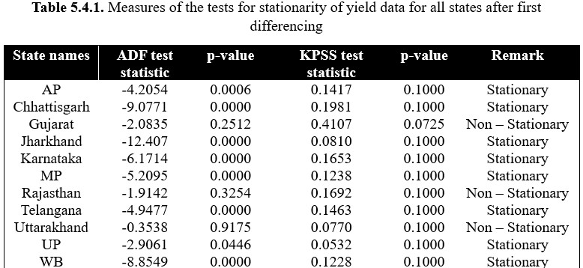
Stationarity: Tests after differencing

Slide 38
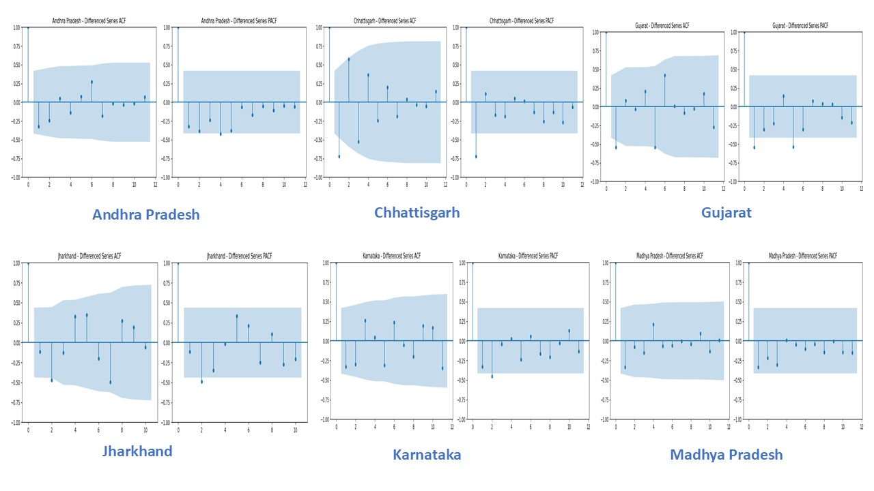
Stationarity: ACF & PACF plots after differencing

Slide 39
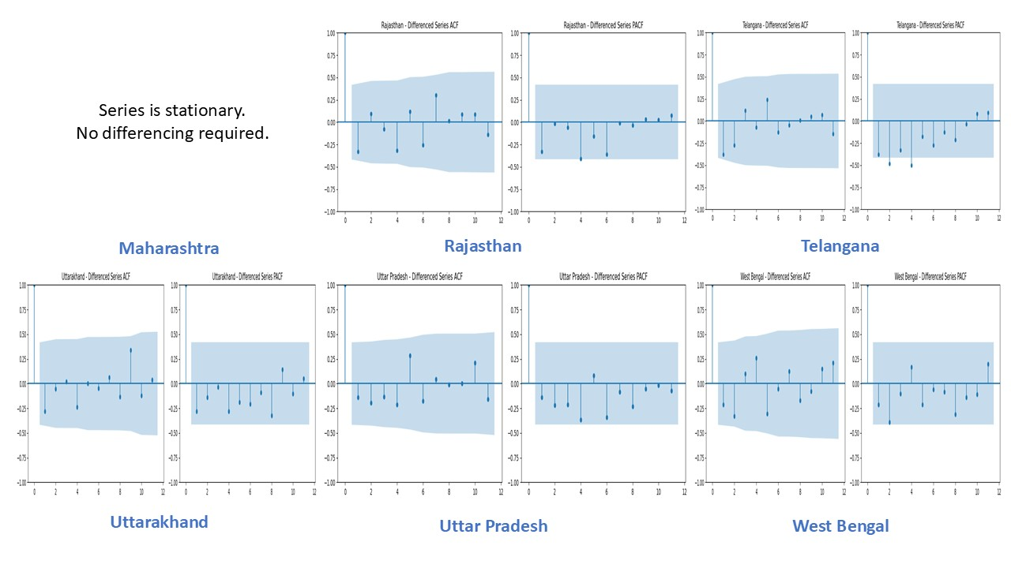
Stationarity: ACF & PACF plots after differencing (Contd.)

Slide 40
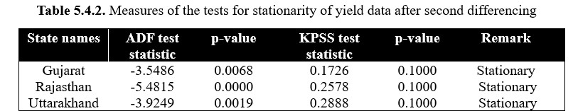
Stationarity: Tests after differencing again

Slide 41
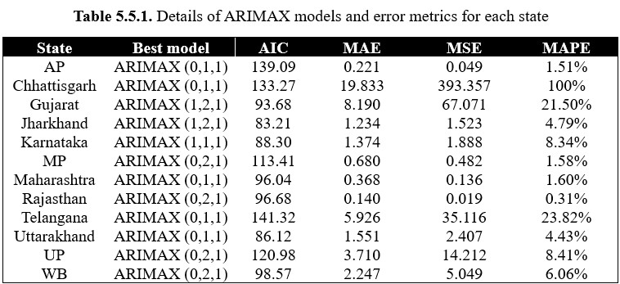
Final Models and Residual Analysis

Slide 42
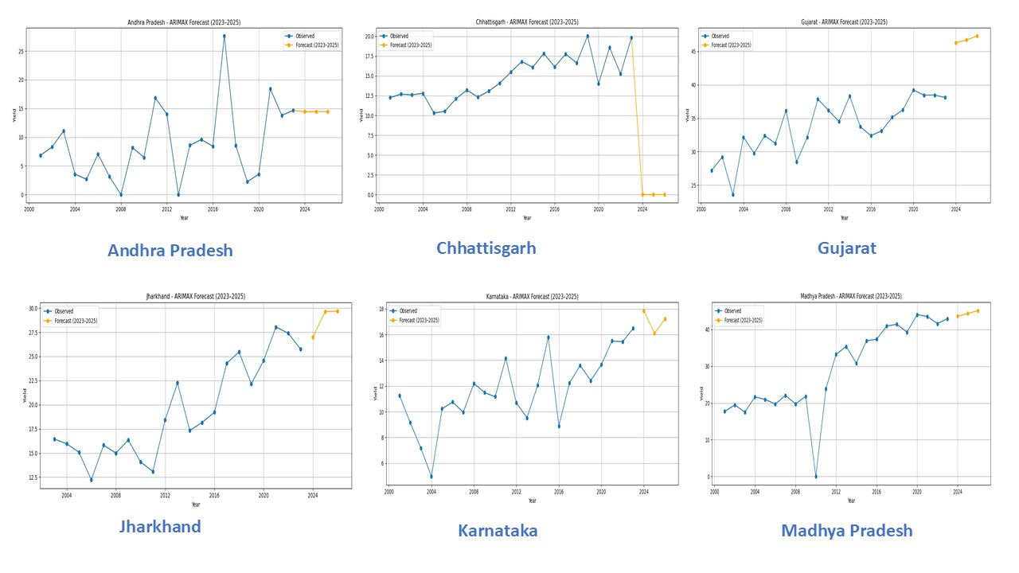
Observed and Forecasted plots

Slide 43
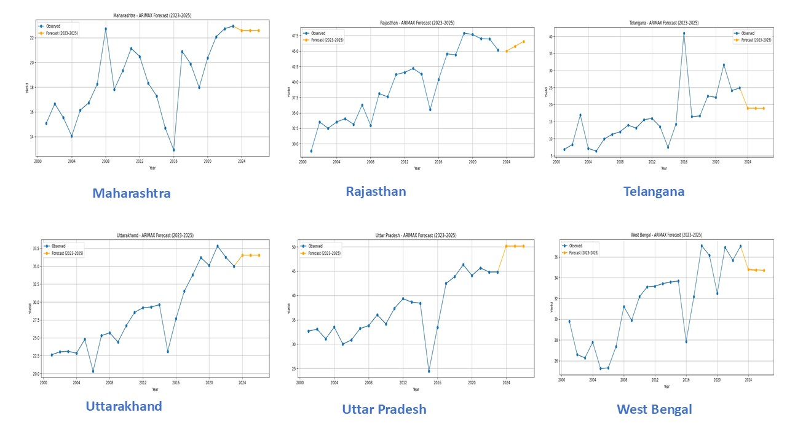
Observed and Forecasted plots (Contd.)

Slide 44
Conclusion

Slide 45
Conclusion
Based on error metrics such as MAE, MAPE and MSE, we conclude
The ARIMAX (0,2,1) model of the state Rajasthan appears to be the best fit followed by ARIMAX (0,2,1) of AP and ARIMAX (0,1,1) of MP.
Performance of ARIMAX (0,1,1) of Chhattisgarh was the worst followed by ARIMAX (0,1,1) of Telangana and ARIMAX (1,2,1) of Gujarat.
ARIMAX models for other states viz. Jharkhand, Karnataka, Maharashtra, Uttarakhand, UP and WB perform decently.
Sufficient data was not available for Odisha and TN.

Slide 46
Future Works

Slide 47
Future works
However, there exists few areas where improvement can still be made. For instance,
The project is done based of annual data computed from daily data. We can convert the daily data into monthly data or even use the daily data only for forecasting.
The exogenous variables can be used individually or even as a group of same kind of variables (e.g. a group including temperature and rainfall, another one including FRL, live cap FRL etc.) to forecast yield.
If proper data is available wheat forecasting can be performed for other states of India as well or even for other crops.

Slide 48
References

Slide 49
References
1. Devi, M., Kumar, J., Malik, D. P., & Mishra, P. (2021). Forecasting of wheat production in Haryana using hybrid time series model. Journal of Agriculture and Food Research, 5, 100175.
2. Bali, N., & Singla, A. (2021). Deep learning-based wheat crop yield prediction model in Punjab region of North India. Applied Artificial Intelligence, 35(15), 1304-1328.
3. Priya, S. K., & Kausalya, N. Forecasting Wheat Crop Area, Production & Productivity in India Using Arimax Model.
4.Banakara, K. B., Sharma, N., Sahoo, S., Dubey, S. K., & Chowdary, V. M. (2023). Evaluation of weather parameter-based pre-harvest yield forecast models for wheat crop: a case study in Saurashtra region of Gujarat. Environmental Monitoring and Assessment, 195(1), 51.
5.Pandit, P., Sagar, A., Ghose, B., Dey, P., Paul, M., Alqadhi, S., ... & Abdo, H. G. (2023). Hybrid time series models with exogenous variable for improved yield forecasting of major Rabi crops in India. Scientific Reports, 13(1), 22240.
6.Verma, U. (2022). ARIMA and ARIMAX models for sugarcane yield forecasting in Northern Agro-climatic zone of Haryana. Journal of Agrometeorology, 24(2), 200-202.
7.Das, Pankaj, and Samir Barman. "Perspective Chapter: An Overview of Time Series Decomposition and Its Applications." Applied and Theoretical Econometrics and Financial Crises (2025): 59.

Slide 50
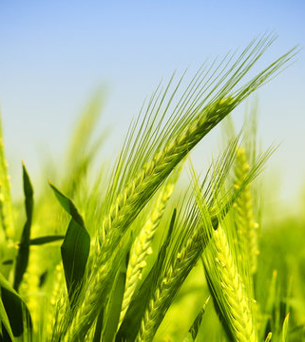
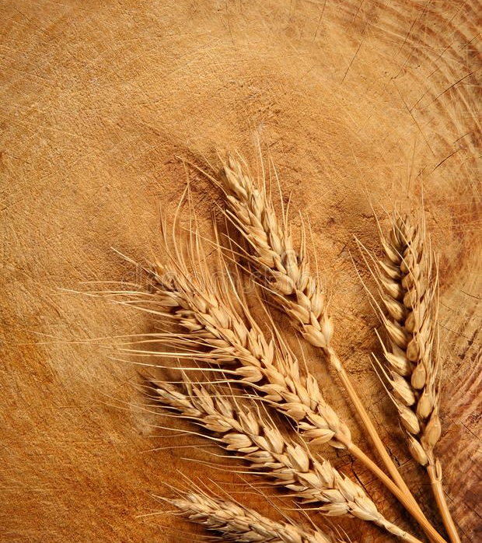
Thank You

